Slide 1
Analyze Twitch Gaming
Data
Analyze Data with SQL
Vlad Chuvardynskyi
16.06.2023

Slide 2
Table of Contents
Task 1. Inspect the names of columns for ‘stream’ and ‘chat’ tables
Task 2. Inspect the unique games names
Task 3. Inspect the channels
Task 4. Define the most common games played
Task 5. Define countries where players ‘League of Legends’ coming from
Task 6. Track the number of platforms used for viewing streams
Task 7. Grouping each of the games by a particular genre
Task 8. Define the number of streams per hour
Task 9. Merge 'stream' and 'chat' tables together

Slide 3
Company’s objectives
Twitch is an American video live streaming service that focuses on video game live streaming, including broadcasts of esports competitions, in addition to offering music broadcasts, creative content, and "in real life" streams. Twitch is operated by Twitch Interactive, a subsidiary of Amazon.com, Inc.

Slide 4
Marketing funnels and purpose:
Purpose: During this project, we will analyze the Twitch database to understand its users and products is one of the main responsibilities of the Twitch Data Science Team.
Given: In this project, we will be working with two tables that contain Twitch users’ stream viewing data (stream table) and chat room usage data (chat table).
The given SQL tables include the following columns:
1. ‘time’ - the time at which the visitor came to the page
2. ‘device_id’ - unique identifier for each visitor to a page
3. ‘login’ - unique number of login session
4. ‘channel’ - identifies through which gamer’s channel the visitor comes to a site
5. ‘country’ - identifies which country the visitor belongs to
6. ‘player’ - identifies which platform the visitor uses to view a stream
7. ‘game’ - name of game that the visitor plays on a site
8. ‘stream_format’ - identifies a stream quality
9. ‘subscriber’ - whether the visitor is a subscriber or not

Slide 5
Task 1. Inspect the names of columns for ‘stream’ and ‘chat’ tables

Slide 6
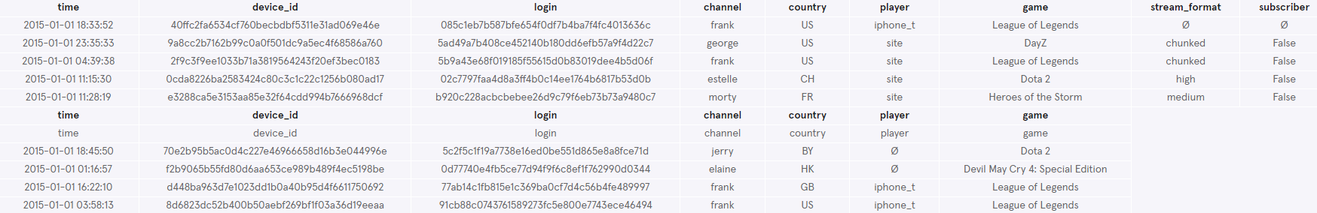
1. Inspect the names of columns for ‘stream’ and ‘chat’ tables
Start by getting a feel for the ‘stream’ table and the ‘chat’ table
What are the column names?
- ’stream’ table: time, device_id, login, channel, country, player, game, stream_format, subscriber
- ’chat’ table: time, device_id, login, channel, country, player, game
SELECT *
FROM stream
LIMIT 5;
SELECT *
FROM chat
LIMIT 5;

Slide 7
Task 2. Inspect the unique games names

Slide 8
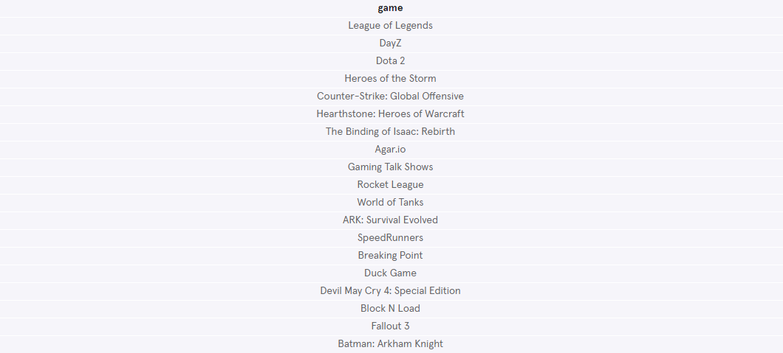
2. Inspect the unique games names
What are the unique games in the stream table?
- There are 20 unique names of games for the ‘stream’ table in the Twitch database:
League of Legends, DayZ, Dota 2, Heroes of the Storm, Counter-Strike: Global Offensive, Hearthstone: Heroes of Warcraft, The Binding of Isaac: Rebirth, Agar.io, Gaming Talk Shows,
Rocket League, World of Tanks, ARK: Survival Evolved, SpeedRunners, Breaking Point, Duck Game, Devil May Cry 4: Special Edition, Block N Load, Fallout 3, Batman: Arkham Knight.
SELECT DISTINCT game
FROM stream
WHERE game IS NOT NULL;

Slide 9
Task 3. Inspect the channels

Slide 10
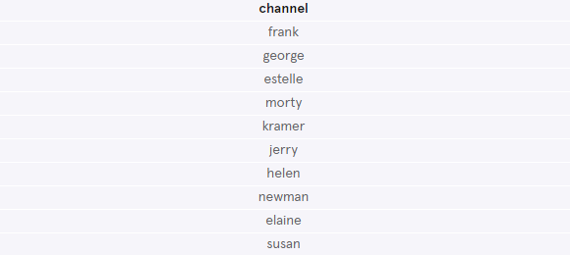
3. Inspect the gamer channels the visitor comes to a site
What are the unique channels in the stream table?
- There are 20 unique names of games for the ‘stream’ table in the Twitch database:
frank, george, estelle, morty, kramer, jerry, helen, newman, elaine, susan.
SELECT DISTINCT channel
FROM stream
WHERE game IS NOT NULL;

Slide 11
Task 4. Define the most common games played

Slide 12
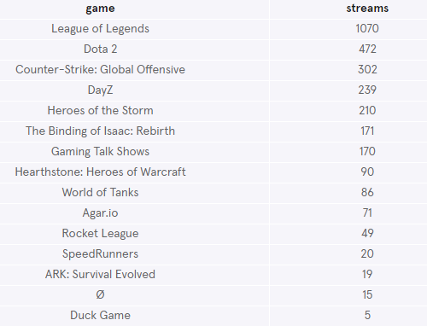
4. Define the most common games played
What are the most popular games in the stream table?
The top three most popular games among visitors are ‘League of Legends’, ‘Dota 2’, and ‘Counter-Strike: Global Offensive’.
SELECT game, COUNT(*) AS 'streams'
FROM stream
GROUP BY 1
ORDER BY 2 DESC
LIMIT 15;

Slide 13
Task 5. Define countries where players of ‘League of Legends’ coming from

Slide 14
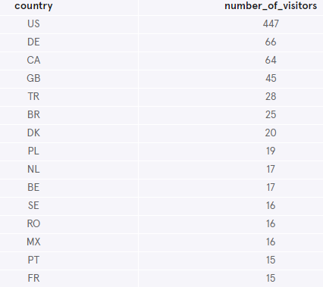
5. Define countries where players of ‘League of Legends’ coming from
What are the country of origin for players of ‘League of Legends’ game?
The five most popular countries among players of ‘League of Legends’ game are the United States (US), Germany (DE), Canada (CA), the Great Britain (GB), and Turkey (TR).
SELECT country, COUNT(*) AS 'number_of_visitors'
FROM stream
WHERE game IS 'League of Legends'
AND country IS NOT NULL
GROUP BY 1
ORDER BY 2 DESC
LIMIT 15;

Slide 15
Task 6. Track the number of platforms used for viewing streams

Slide 16
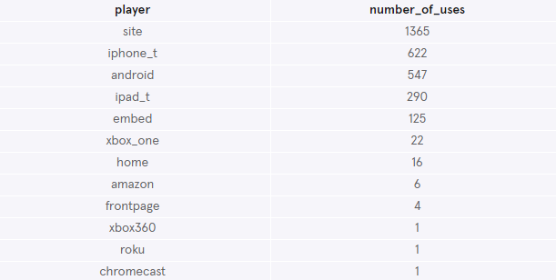
6. Track the number of platforms used for viewing streams
Create a list of players and their number of streamers
The most frequent used platform to view streams among visitors are site, iPhone, and Android platforms.
SELECT player, COUNT(*) AS 'number_of_uses'
FROM stream
GROUP BY 1
ORDER BY 2 DESC;

Slide 17
Task 7. Grouping each of the games by a particular genre

Slide 18
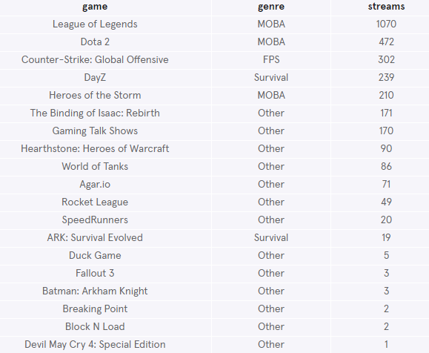
7. Genre grouping
Create a new column named genre for each of the games
Group the games into their genres: Multiplayer Online Battle Arena (MOBA), First Person Shooter (FPS), Survival, and Other.
SELECT game,
CASE
WHEN game = 'Dota 2'
THEN 'MOBA'
WHEN game = 'League of Legends'
THEN 'MOBA'
WHEN game = 'Heroes of the Storm'
THEN 'MOBA'
WHEN game = 'DayZ'
THEN 'Survival'
WHEN game = 'ARK: Survival Evolved'
THEN 'Survival'
WHEN game = 'Counter-Strike: Global Offensive'
THEN 'FPS'
ELSE 'Other'
END AS 'genre',
COUNT(*) AS 'streams'
FROM stream
WHERE game IS NOT NULL
GROUP BY 1
ORDER BY 3 DESC;

Slide 19
Task 8. Define the number of streams per hour

Slide 20
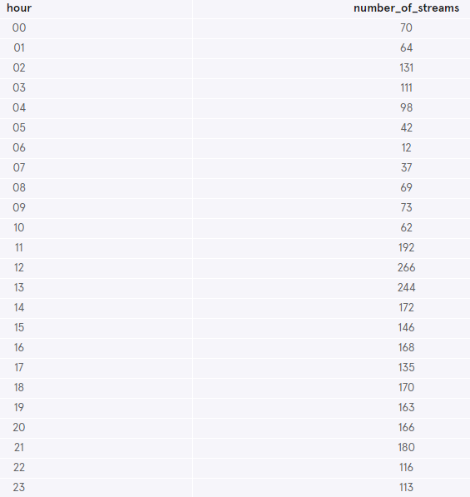
8. Define the number of streams per hour
Return the number of streams viewed worldwide for a particular hour
The top hours for streaming are between 11:00 and 14:00
SELECT strftime('%H', time) AS 'hour', COUNT(*) as 'number_of_streams'
FROM stream
GROUP BY 1;

Slide 21
Task 9. Merge 'stream' and 'chat' tables together

Slide 22
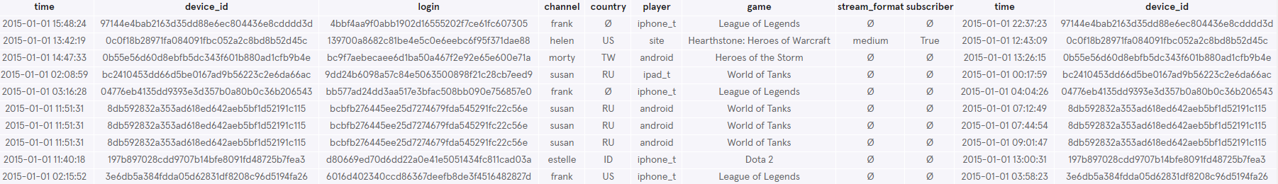
9. Merge 'stream' and 'chat' tables together
Join the 'stream' and 'chat' tables together
SELECT *
FROM stream AS s
JOIN chat AS c
ON s.device_id = c.device_id
LIMIT 10;

